Slide 1
Chapter 25
Process and Project Metrics
These slides are designed to accompany Software Engineering: A Practitioner’s Approach, 7/e (McGraw-Hill 2009). Slides copyright 2009 by Roger Pressman.

Slide 2
A Good Manager Measures
process
process metrics
project metrics
measurement
product metrics
product
What do we
use as a
basis?
• size?
• function?
These slides are designed to accompany Software Engineering: A Practitioner’s Approach, 7/e (McGraw-Hill 2009). Slides copyright 2009 by Roger Pressman.

Slide 3
Why Do We Measure?
assess the status of an ongoing project
track potential risks
uncover problem areas before they go “critical,”
adjust work flow or tasks,
evaluate the project team’s ability to control quality of software work products.
These slides are designed to accompany Software Engineering: A Practitioner’s Approach, 7/e (McGraw-Hill 2009). Slides copyright 2009 by Roger Pressman.

Slide 4
Process Measurement
We measure the efficacy of a software process indirectly.
  That is, we derive a set of metrics based on the outcomes that can be derived from the process.
  Outcomes include
    measures of errors uncovered before release of the software
    defects delivered to and reported by end-users
    work products delivered (productivity)
    human effort expended
    calendar time expended
    schedule conformance
    other measures.
We also derive process metrics by measuring the characteristics of specific software engineering tasks.
These slides are designed to accompany Software Engineering: A Practitioner’s Approach, 7/e (McGraw-Hill 2009). Slides copyright 2009 by Roger Pressman.

Slide 5
Process Metrics Guidelines
Use common sense and organizational sensitivity when interpreting metrics data.
Provide regular feedback to the individuals and teams who collect measures and metrics.
Don’t use metrics to appraise individuals.
Work with practitioners and teams to set clear goals and metrics that will be used to achieve them.
Never use metrics to threaten individuals or teams.
Metrics data that indicate a problem area should not be considered “negative.” These data are merely an indicator for process improvement.
Don’t obsess on a single metric to the exclusion of other important metrics.
These slides are designed to accompany Software Engineering: A Practitioner’s Approach, 7/e (McGraw-Hill 2009). Slides copyright 2009 by Roger Pressman.

Slide 6
Software Process Improvement
Process model
SPI
Process improvement
recommendations
Improvement goals
Process metrics
These slides are designed to accompany Software Engineering: A Practitioner’s Approach, 7/e (McGraw-Hill 2009). Slides copyright 2009 by Roger Pressman.

Slide 7
Process Metrics
Quality-related
  focus on quality of work products and deliverables
Productivity-related
  Production of work-products related to effort expended
Statistical SQA data
  error categorization & analysis
Defect removal efficiency
  propagation of errors from process activity to activity
Reuse data
  The number of components produced and their degree of reusability
These slides are designed to accompany Software Engineering: A Practitioner’s Approach, 7/e (McGraw-Hill 2009). Slides copyright 2009 by Roger Pressman.

Slide 8
Project Metrics
used to minimize the development schedule by making the adjustments necessary to avoid delays and mitigate potential problems and risks
used to assess product quality on an ongoing basis and, when necessary, modify the technical approach to improve quality.
every project should measure:
  inputs—measures of the resources (e.g., people, tools) required to do the work.
  outputs—measures of the deliverables or work products created during the software engineering process.
  results—measures that indicate the effectiveness of the deliverables.
These slides are designed to accompany Software Engineering: A Practitioner’s Approach, 7/e (McGraw-Hill 2009). Slides copyright 2009 by Roger Pressman.

Slide 9
Typical Project Metrics
Effort/time per software engineering task
Errors uncovered per review hour
Scheduled vs. actual milestone dates
Changes (number) and their characteristics
Distribution of effort on software engineering tasks
These slides are designed to accompany Software Engineering: A Practitioner’s Approach, 7/e (McGraw-Hill 2009). Slides copyright 2009 by Roger Pressman.

Slide 10
Metrics Guidelines
Use common sense and organizational sensitivity when interpreting metrics data.
Provide regular feedback to the individuals and teams who have worked to collect measures and metrics.
Don’t use metrics to appraise individuals.
Work with practitioners and teams to set clear goals and metrics that will be used to achieve them.
Never use metrics to threaten individuals or teams.
Metrics data that indicate a problem area should not be considered “negative.” These data are merely an indicator for process improvement.
Don’t obsess on a single metric to the exclusion of other important metrics.
These slides are designed to accompany Software Engineering: A Practitioner’s Approach, 7/e (McGraw-Hill 2009). Slides copyright 2009 by Roger Pressman.

Slide 11
Software measurement
Direct measures of the product include lines of code (LOC) produced, execution speed,
memory size, and defects reported over some set period of time.
Indirect measures of the product include functionality, quality, complexity, efficiency, reliability, maintainability,and many other “–abilities”
These slides are designed to accompany Software Engineering: A Practitioner’s Approach, 7/e (McGraw-Hill 2009). Slides copyright 2009 by Roger Pressman.

Slide 12
Size-Oriented Metrics
Size-oriented software metrics are derived by normalizing quality and/or productivity measures by considering the size of the software that has been produced.
These slides are designed to accompany Software Engineering: A Practitioner’s Approach, 7/e (McGraw-Hill 2009). Slides copyright 2009 by Roger Pressman.

Slide 13
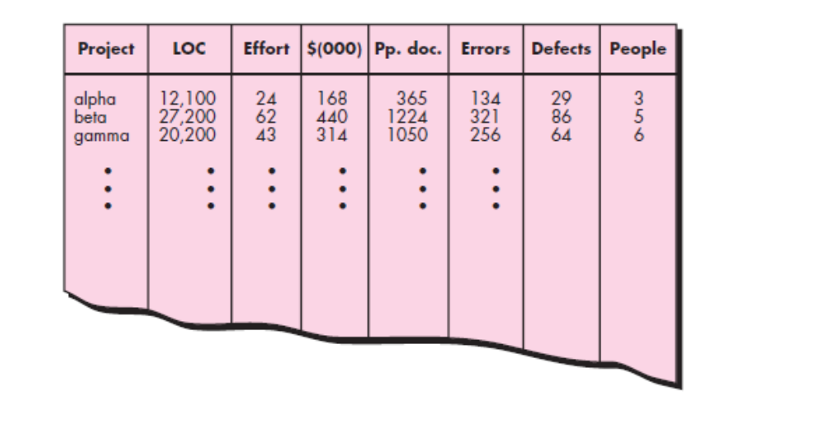
Eg:Table of Size-Oriented Metrics for different projects
These slides are designed to accompany Software Engineering: A Practitioner’s Approach, 7/e (McGraw-Hill 2009). Slides copyright 2009 by Roger Pressman.

Slide 14
For project alpha: 12,100 lines of code were developed with 24 person-months of effort at a cost of $168,000.
It should be noted that the effort and cost recorded in the table represent all software engineering activities (analysis, design, code, and test), not just coding.
Further information for project alpha indicates that 365 pages of documentation were developed, 134 errors were recorded before the software was released, and 29 defects were encountered after release to the customer within the first year of operation.
Three people worked on the development of software for project alpha.
These slides are designed to accompany Software Engineering: A Practitioner’s Approach, 7/e (McGraw-Hill 2009). Slides copyright 2009 by Roger Pressman.

Slide 15
Typical Size-Oriented Metrics
errors per KLOC (thousand lines of code)
defects per KLOC
$ per LOC
pages of documentation per KLOC
errors per person-month
errors per review hour
LOC per person-month
$ per page of documentation
These slides are designed to accompany Software Engineering: A Practitioner’s Approach, 7/e (McGraw-Hill 2009). Slides copyright 2009 by Roger Pressman.

Slide 16
Size-oriented metrics are not universally accepted as the best way to measure the
software process.
LOC measures are programming language dependent, that when productivity is considered, they penalize well-designed but shorter programs; that they cannot easily accommodate nonprocedural languages; and that their use in estimation requires a level of detail that may be difficult to achieve
These slides are designed to accompany Software Engineering: A Practitioner’s Approach, 7/e (McGraw-Hill 2009). Slides copyright 2009 by Roger Pressman.

Slide 17
Function-Oriented Metrics
Function-oriented software metrics use a measure of the functionality delivered by
the application as a normalization value.
The most widely used function-oriented
metric is the function point (FP).
Computation of the function point is based on characteristics of the software’s information domain and complexity.
These slides are designed to accompany Software Engineering: A Practitioner’s Approach, 7/e (McGraw-Hill 2009). Slides copyright 2009 by Roger Pressman.

Slide 18
Typical Function-Oriented Metrics
errors per FP (thousand lines of code)
defects per FP
$ per FP
pages of documentation per FP
FP per person-month
These slides are designed to accompany Software Engineering: A Practitioner’s Approach, 7/e (McGraw-Hill 2009). Slides copyright 2009 by Roger Pressman.

Slide 19
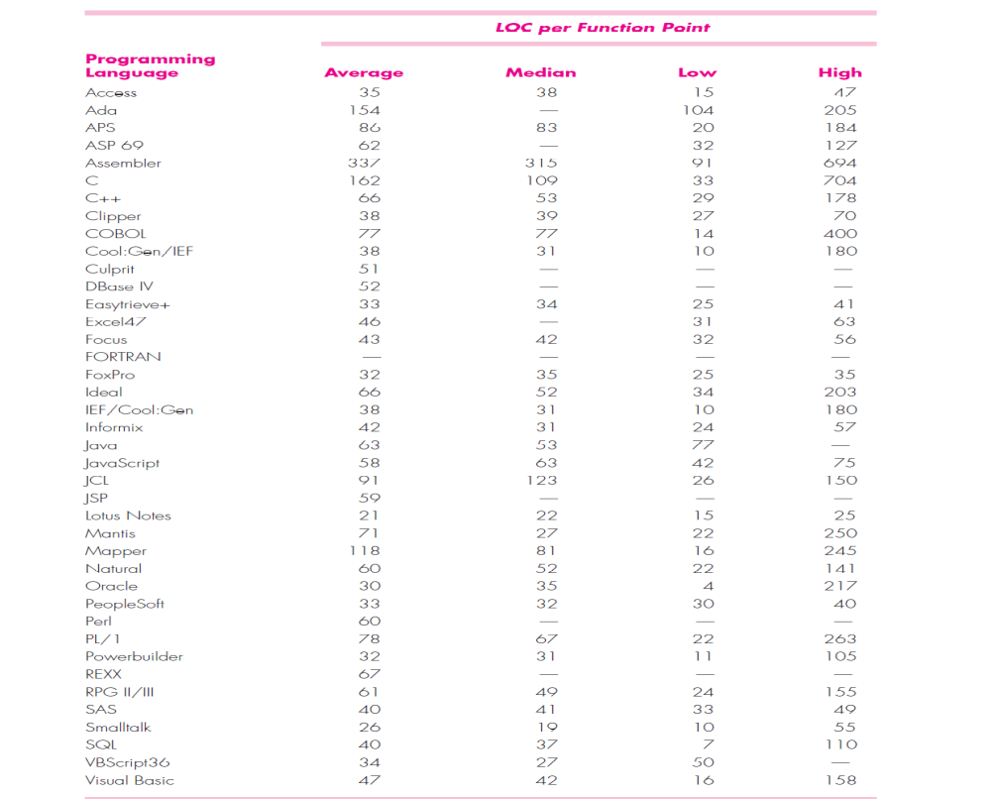
Comparing LOC and FP
Representative values developed by QSM
These slides are designed to accompany Software Engineering: A Practitioner’s Approach, 7/e (McGraw-Hill 2009). Slides copyright 2009 by Roger Pressman.

Slide 20
Why Opt for FP?
Programming language independent
Used readily countable characteristics that are determined early in the software process
Does not “penalize” inventive (short) implementations that use fewer LOC that other more clumsy versions
Makes it easier to measure the impact of reusable components
These slides are designed to accompany Software Engineering: A Practitioner’s Approach, 7/e (McGraw-Hill 2009). Slides copyright 2009 by Roger Pressman.

Slide 21
Object-Oriented Metrics
Number of scenario scripts (use-cases)
Number of support classes (required to implement the system but are not immediately related to the problem domain)
Average number of support classes per key class (analysis class)
Number of subsystems (an aggregation of classes that support a function that is visible to the end-user of a system)
These slides are designed to accompany Software Engineering: A Practitioner’s Approach, 7/e (McGraw-Hill 2009). Slides copyright 2009 by Roger Pressman.

Slide 22
WebApp Project Metrics
Number of static Web pages (the end-user has no control over the content displayed on the page)
Number of dynamic Web pages (end-user actions result in customized content displayed on the page)
Number of internal page links (internal page links are pointers that provide a hyperlink to some other Web page within the WebApp)
Number of persistent data objects
Number of external systems interfaced
Number of static content objects
Number of dynamic content objects
Number of executable functions
These slides are designed to accompany Software Engineering: A Practitioner’s Approach, 7/e (McGraw-Hill 2009). Slides copyright 2009 by Roger Pressman.

Slide 23
Measuring Quality
Correctness — the degree to which a program operates according to specification
Maintainability—the degree to which a program is amenable to change
Integrity—the degree to which a program is impervious to outside attack
Usability—the degree to which a program is easy to use
These slides are designed to accompany Software Engineering: A Practitioner’s Approach, 7/e (McGraw-Hill 2009). Slides copyright 2009 by Roger Pressman.

Slide 24
Defect Removal Efficiency
DRE = E /(E + D)
where:
E is the number of errors found before delivery of the software to the end-user
D is the number of defects found after delivery.
These slides are designed to accompany Software Engineering: A Practitioner’s Approach, 7/e (McGraw-Hill 2009). Slides copyright 2009 by Roger Pressman.

